Slide 1
Benchmarking for Long-Term Research Management: The Common Task Method
Mark Liberman
The University of Pennsylvania

Slide 2
Abstract:
Over the course of half a century, DARPA's Human Language Technology program created capabilities such as speech recognition, machine translation, and text understanding, turning them from science fiction fantasies to everyday practical fact.
This sustained success was based on the development of the Common Task Method, which allowed decades of incremental progress in advance of commercial viability. I'll describe the origin and (sometimes counter-intuitive) progress of this method, distinguish it from other uses of benchmarking, and speculate about its future.

Slide 3
What is a “benchmark”?
Originally (from the Oxford English Dictionary):
A fixed point (esp. a cut or mark in a wall, building, etc.), used by a surveyor as a reference in measuring elevations.
Typically, such a mark takes the form of a horizontal groove cut in a surface, into which the upper surface of an angle iron would once have been inserted, forming a level surface or ‘bench’ to support a levelling staff.

Slide 4
Figuratively:
In extended use. A point of reference, esp. one from which measurements may be made; something that serves as a standard by which other similar things may be measured or evaluated; spec. a standardized problem or test used for evaluation or comparison.

Slide 5
What are those figurative “benchmarks” for?
(Selling stuff) Our widget is the best!
(Buying stuff) Which widget is the best choice for this task?
(Process planning) How much X do we need to do this?
(Process management) How much X are we using to do this?
(Education) Which students have learned what?
… and so on …

Slide 6
As diverse as they are,
those benchmarks all aim at near-term action –
buying, selling, planning, evaluation –
in an on-going practical situation.
A different kind of benchmarking played a crucial role in the history of Human Language Technology.

Slide 7
These days, HLT is more and more widely used.
There are four secrets to its success:
Better algorithms
Cheap fast digital hardware
Ubiquitous digital networking
A research management technique developed in the 1980s and applied increasingly widely since then
The first three driving forces are obvious, but the third involves some semi-obscure intellectual history.

Slide 8
The foundation: a series of HLT failures
In the 1960s and 1970s, there were many projects focused on
machine translation, natural-language interaction with databases,
speech recognition, and speech synthesis.
Based on human-coded rules or constraints, these generally worked to some extent – but they were
limited in scope,
brittle under even modest changes in context,
expensive to create and port,
and generally disappointing in performance anyhow.

Slide 9
Many influential people concluded that these endeavors were hopeless.
A leader in pushing this narrative was John Pierce.
Pierce supervised the team that built the first transistor,
and oversaw development
of the first communications satellite.
So his opinion carried considerable weight.

Slide 10
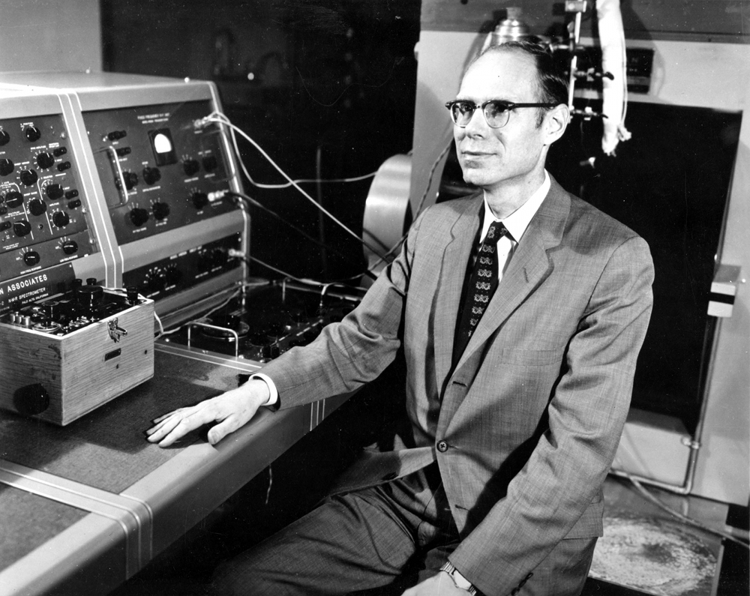

Slide 11
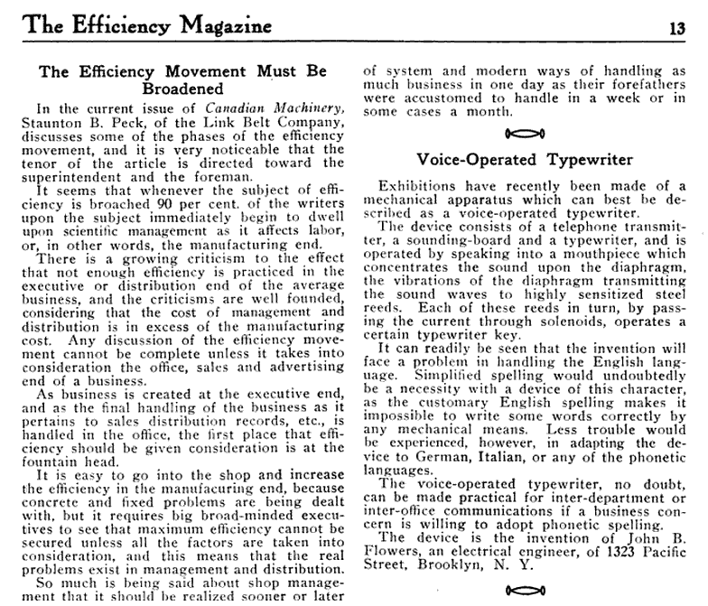
Why Pierce was skeptical,
Part 1 of Many –
From The Efficiency Magazine
(“for the man studying selling, system and advertising”),
September 1913:

Slide 12
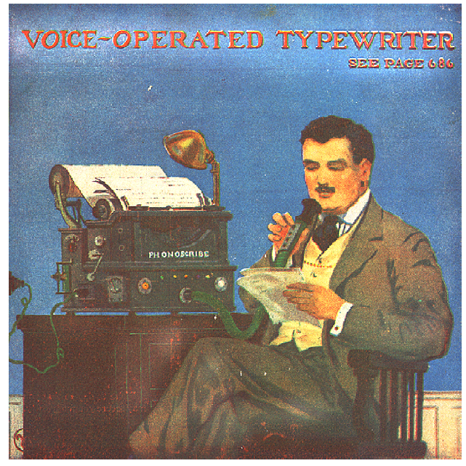
The cover of The Electrical Experimenter,
April 1916, showed Flower’s device:
The subsequent 50 years
saw promise after promise
and failure after failure…

Slide 13
John Pierce, “Whither Speech Recognition?”, JASA 1969:
“… a general phonetic typewriter is simply impossible unless the typewriter has an intelligence and a knowledge of language comparable to those of a native speaker of English.”
“Most recognizers behave, not like scientists, but like mad inventors or untrustworthy engineers. The typical recognizer gets it into his head that he can solve ‘the problem.’ The basis for this is either individual inspiration (the ‘mad inventor’ source of knowledge) or acceptance of untested rules, schemes, or information (the untrustworthy engineer approach). . . .”
“The typical recognizer ... builds or programs an elaborate system that either does very little or flops in an obscure way. A lot of money and time are spent. No simple, clear, sure knowledge is gained. The work has been an experience, not an experiment.”

Slide 14
Tell us what you really think, John . . .
“We are safe in asserting that speech recognition is attractive to money. The attraction is perhaps similar to the attraction of schemes for turning water into gasoline, extracting gold from the sea, curing cancer, or going to the moon. One doesn’t attract thoughtlessly given dollars by means of schemes for cutting the cost of soap by 10%. To sell suckers, one uses deceit and offers glamor.”
“It is clear that glamor and any deceit in the field of speech recognition blind the takers of funds as much as they blind the givers of funds. Thus, we may pity workers whom we cannot respect.”

Slide 15
Fallout from these blasts
The first idea: Try Artificial Intelligence . . .
DARPA Speech Understanding Research Project (1972-75)
Used classical AI to try to “understand what is being said with something of the facility of a native speaker”
DARPA SUR was viewed as a failure; funding was cut off after three years
The second idea: Give Up.
1975-1986: No U.S. research funding for MT or ASR

Slide 16
Pierce was far from the only person with a jaundiced view of R&D investment in the area of human language technology.
By the mid 1980s, many informed American research managers were equally skeptical about the prospects.
At the same time, many people believed that HLT was needed and in principle was feasible.

Slide 17
So in 1985, DARPA restarted HLT support
Some smart program managers had an idea.
They designed a speech recognition research program that
protects against “glamour and deceit”
because there is a well-defined, objective evaluation metric
applied by a neutral agent (NIST)
on shared data sets; and
and ensures that “simple, clear, sure knowledge is gained”
because participants must reveal their methods
to the sponsor and to one another
at the time that the evaluation results are presented

Slide 18
Needed: Published data and well-defined metrics
David Pallett, "Performance Assessment of Automatic Speech Recognizers”, J. of Research of the National Bureau of Standards, 1985:
Definitive tests to fully characterize automatic speech recognizer or system performance cannot be specified at present. However, it is possible to design and conduct performance assessment tests that make use of widely available speech data bases, use test procedures similar to those used by others, and that are well documented. These tests provide valuable benchmark data and informative, though limited, predictive power.
By contrast, tests that make use of speech data bases that are not made available to others and for which the test procedures and results are poorly documented provide little objective information on system performance.

Slide 19
“Common Task” structure
A detailed task definition and “evaluation plan”
developed in consultation with researchers
and published as the first step in the project.
Automatic evaluation software
written and maintained by NIST
and published at the start of the project.
Shared data:
Training and “dev(elopment) test” data is published at start of project;
“eval(uation) test” data is withheld for periodic public evaluations

Slide 20
Not everyone liked it
Many Piercians were skeptical:
“You can’t turn water into gasoline, no matter what you measure.”
Many researchers were disgruntled:
“It’s like being in first grade again -- you’re told exactly what to do, and then you’re tested over and over .”
But it worked.

Slide 21
Why did it work?
The obvious: it allowed funding to start
(because the projects were glamour-and-deceit-proof)
and to continue
(because funders could measure progress over time)

Slide 22
Why did it work?
Less obvious: it allowed project-internal hill climbing
because the evaluation metrics were automatic
and the evaluation code was public
This obvious way of working was a new idea to many! … and researchers who had objected to be tested twice a year began testing themselves every hour…

Slide 23
Why did it work?
Even less obvious: it created a culture
(because researchers shared methods and results on shared data with a common metric)
Participation in this culture became so valuable that many research groups joined without funding

Slide 24
What else it did
The common task method created a positive feedback loop.
When everyone’s program has to interpret the same ambiguous evidence, ambiguity resolution becomes a sort of gambling game, which rewards the use of statistical methods, and led to the flowering of “machine learning”.
Given the nature of speech and language, statistical methods need the largest possible training set, which reinforces the value of shared data.
Iterated train-and-test cycles on this gambling game are addictive; they create “simple, clear, sure knowledge”, which motivates participation in the common-task culture.

Slide 25
The “Common Task Method”
. . . has become the standard research paradigm in experimental computational science:
Published training and testing data
Well-defined evaluation metrics
Techniques to avoid over-fitting
(managerial as well as statistical)
Domain: Algorithmic analysis of the natural world.

Slide 26
Over the past 35 years, variants of this method have been applied to many other problems:
machine translation, speaker identification, language identification, parsing, sense disambiguation, information retrieval, information extraction, summarization, question answering, OCR, sentiment analysis, image analysis, video analysis, … , etc.
The general experience:
1. Error rates decline by a fixed percentage each year,
to an asymptote depending on task and data quality
2. Progress usually comes from many small improvements;
improvement by 1% is a reason to break out the champagne.
3. Shared data plays a crucial role – and is re-used in unexpected ways.
4. Glamour and deceit have mostly been avoided.

Slide 27
Versions of the “common task” model are now routinely used, outside of any sponsored projects, by both academic and industrial researchers –
and similar “challenges” are routinely created by technical societies and ad hoc groups.
A note in passing: There are several important areas that are lagging far behind, both in technology and in methodology:
Clinical applications
Educational applications
Legal applications
A cultural change in those fields is long overdue!

Slide 28
As AI and HLT have advanced, benchmarking has assumed a more traditional role
in assessing and comparing practical systems.
But benchmarking of practical technologies is different
from benchmarking for decade-scale research management.
In fact, in some ways they’re opposite.

Slide 29
For decade-scale technology development, we need efficient metrics aimed in the general direction of distant goals.
“Efficient” means that lots of things can be tried quickly
(where quickness is relative to current systems)
“General direction” means that better results are probably progress (even if the metric is too crude to validate actual applications)
“Distant goals” means that we’re not working on specific applications (though demo systems are always in order)

Slide 30
Successful HLT “Common Task” metrics can be very crude, e.g.
”Word Error Rate” (as if all mistaken words are equally important)
“Bleu” translation metric (as if word order doesn’t matter)
It’s easy to create examples where these metrics fail.
But they point in the right direction at certain stages of development.

Slide 31
Near-term technology evaluation
needs metrics aimed at specific (classes of) real applications.
The cost function must be appropriate for the application –
thus W.E.R. (and other word-based metrics) now need to weight mistakes according to the effect on downstream decisions
(which might be human or automatic).
Accurate evaluation of this kind is task-specific, time-consuming, and expensive.

Slide 32
There’s also an intermediate case, where we want to compare different algorithms (or just different parameter settings) on a general class of now-practical technologies.
Except for the “practical” part, this is the same as the historical Common Task Method.
But tuning a working algorithm, using a long-established metric, is different from devising a new metric to help us explore a space of solutions for a problem that no one now knows how to solve.

Slide 33
We need to do a better job of benchmarking HLT R&D at all scales of time and all levels of task specificity.
But decade-scale technology development requires a special kind of creativity in devising, evolving, and applying metrics.
And funders, managers, and researchers all have a role to play in that process.

Slide 34
Thank you for your attention!

